Slide 1
Supervised Learning
By DSU Team

Slide 2
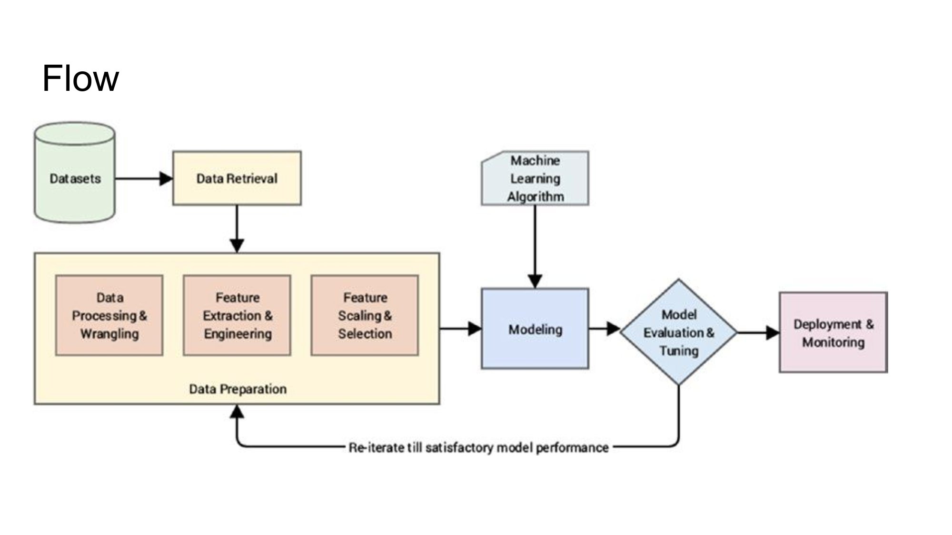

Slide 4
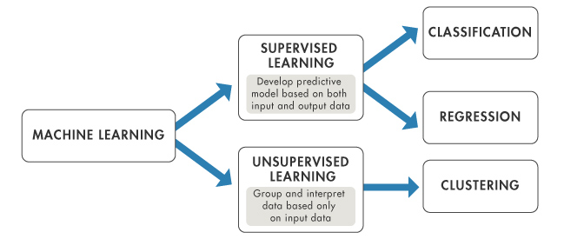
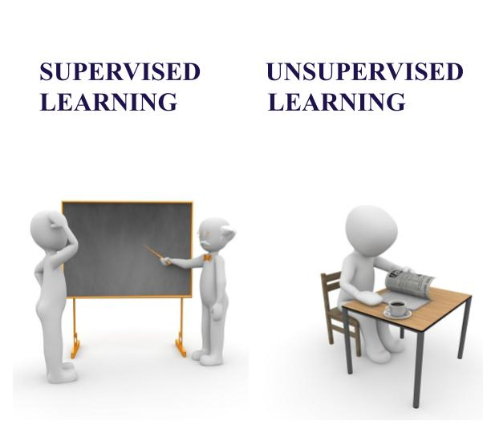

Slide 5
What is Supervised Learning?

Slide 6
Membuat model predictive dari dataset yang ada labelnya

Slide 7
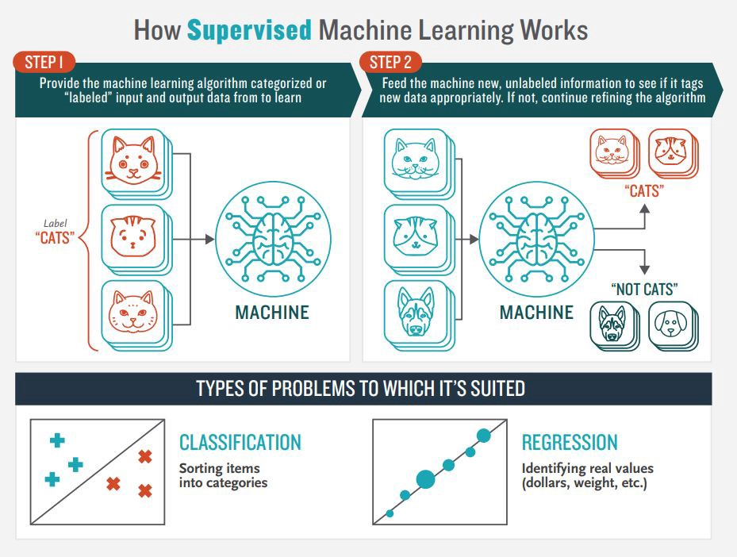

Slide 8

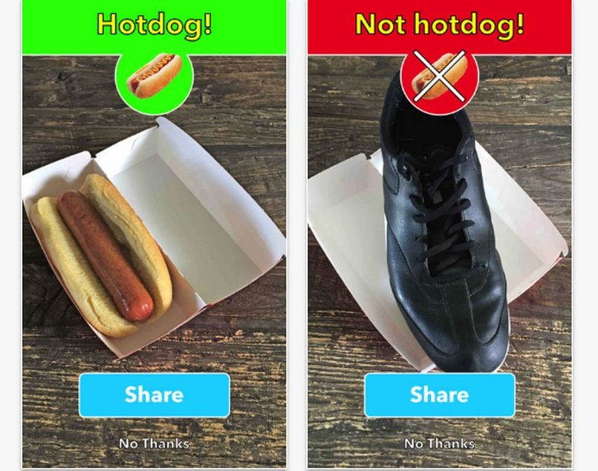
Regression
(labelnya kontinu)
Classification
(labelnya nominal)

Slide 9
Preprocessing
Cleaning Data
Mengatasi missing value
Menghaluskan noisy data
Menghilangkan outliers

Slide 10
Algoritma Supervised Learning
Klasifikasi
K-Nearest Neighbor (KNN)
Naive Bayes
Logistic Regression
Random Forest
Regresi
Linear Regression
Multiple Linear Regression
Polynomial Regression
Random Forest

Slide 11
Studi Kasus
https://rickorinaldy.github.io/bank-data-marketing-classification.html

Slide 12
Referensi Belajar
Bacaan - IBM Supervised Learning
https://www.ibm.com/cloud/learn/supervised-learning
Tontonan Youtube - JCOp untuk Indonesia
https://www.youtube.com/playlist?list=PLGn1wRmlR3MvipYvFEnnmaTwd59XjSyrG

